Slide 1
SQL for Data Analysis

Slide 2
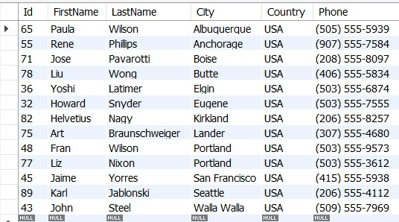
BASIC SELECT + FILTERING + SORTING
1.List all customers from USA sorted by their City.
Code:
select * from customer where Country ='USA' order by City;

Slide 3
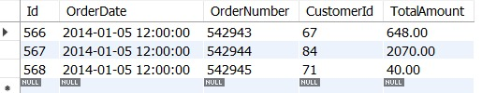

2.Retrieve the details of all orders placed in 2014-01-05. code: select * from orders where date_format(orderdate,'%Y-%m-%d') = '2014-01-05';
3.List all customers, they haven’t placed any orders. Code: select concat(c.firstname,' ',c.lastname) as customer_name,o.id from customer c left join orders o on c.id=o.customerid where id is null;

Slide 4
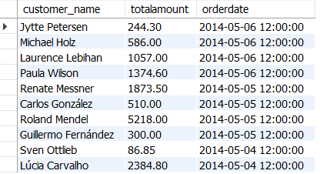
4.Show the top 10 most recent orders with customer names and total amount. Code: select concat(firstname,' ',lastname) as customer_name,totalamount, orderdate from customer c join orders o on c.id=o.customerid order by orderdate desc limit 10;

Slide 5
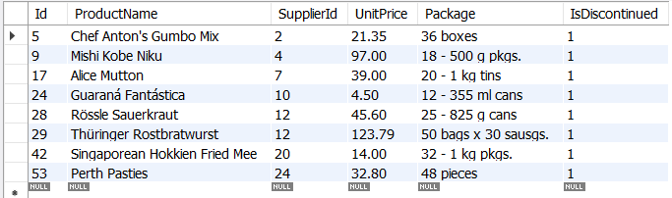
5.Find all discontinued products. Code: select * from product where IsDiscontinued is not null and IsDiscontinued > 0;

Slide 6
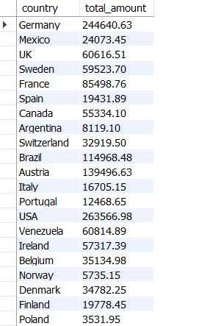
AGGREGATIONS + GROUP BY
6.Calculate the total sales (sum of TotalAmount) for each country.
Code:
select country,sum(totalamount) as total_amount from customer c join orders o on c.id=o.CustomerIdgroup by 1;

Slide 7
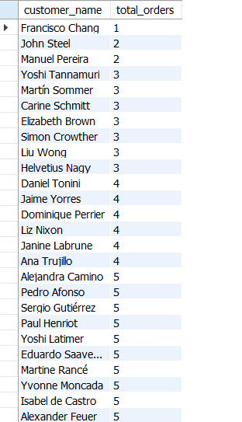
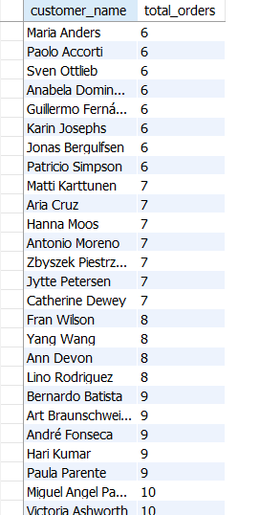
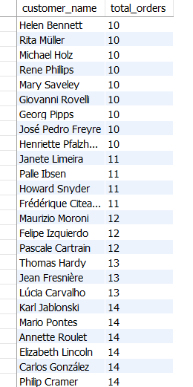
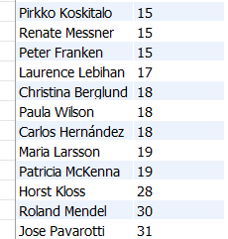
7.Show total number of orders placed by each customer. Code: select concat(firstname,' ',lastname) as customer_name,count(customerid) as total_orders from customer c join orders o on c.id=o.CustomerId group by 1 order by 2 ;

Slide 8
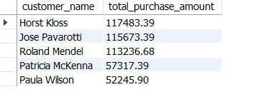
8.Find the top 5 customers based on the total purchase amount. Code: select concat(firstname,' ',lastname) as customer_name, sum(totalamount) as total_purchase_amount from customer c join orders o on c.id=o.customeridgroup by 1 order by 2 desc limit 5;

Slide 9
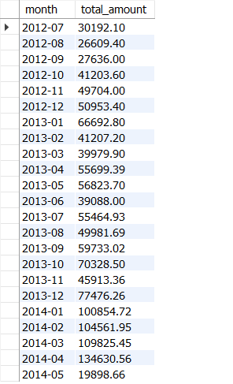
9.Display monthly total sales from the orders table. Code: select date_format(orderdate,'%Y-%m') as month,sum(totalamount) as total_amount from orders group by 1 ;

Slide 10
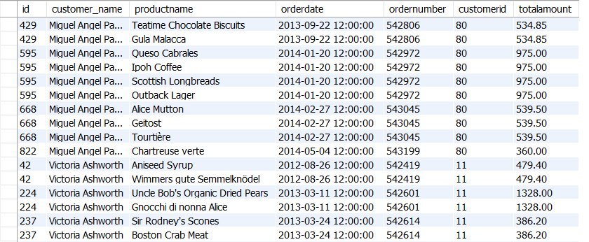
JOINs (INNER, LEFT, RIGHT)
10.List order details with product names and customer names.
Code:
select o.id, concat(c.firstname,' ',c.lastname) ascustomer_name,p.productname, o.orderdate, o.ordernumber, o.customerid,o.totalamountfrom customer c join orders o on c.id=o.customerid join orderitem oi on o.id = oi.OrderId join
product p on oi.ProductId = p.id;

Slide 11
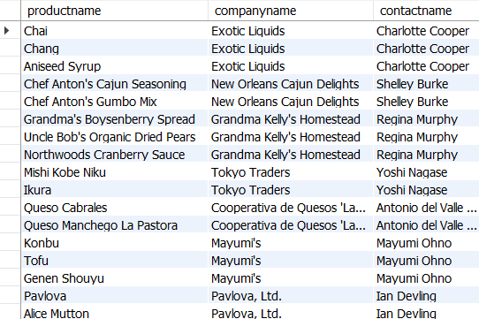
11.Show all products and their supplier names, even if some suppliers didn’t supply anything (LEFT JOIN) code: select productname,s.companyname,s.contactname from product p left join supplier s on p.SupplierId = s.Id;

Slide 12
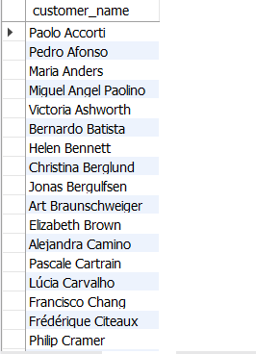
12.List customers who placed orders. Code: select distinct concat(c.firstname,' ',c.lastname) as customer_name from customer c inner join orders o on c.id=o.customerid;

Slide 13
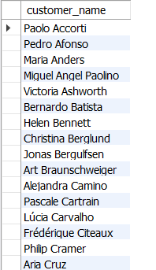
SUBQUERIES
13.Find customers who ordered more than 3 times.
Code:
select concat(firstname,' ',lastname) as customer_namefrom customer where id in (select customerid from orders group by customerid having count(*) > 3 );

Slide 14
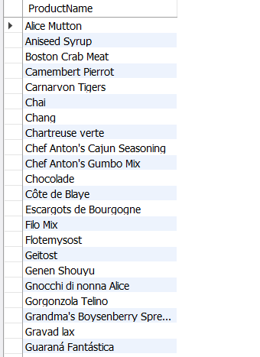
14.List products that have been ordered more than 100 times total. Code: Select p.ProductName from product p join orderitem oi on p.Id = oi.ProductId group by p.Id, p.ProductName having SUM(oi.Quantity) > 100;

Slide 15


15.Find the highest spending customer. Code: select concat(firstname,' ',lastname) as customer_name ,sum(totalamount) as total_amount_spent from customer c join orders o on c.id=o.CustomerIdgroup by 1 order by 2 desc limit 1;
16.Show the number of distinct products ordered.
Code:
select count(distinct productid) as Distinct_Products_Ordered from orderitem;

Slide 16
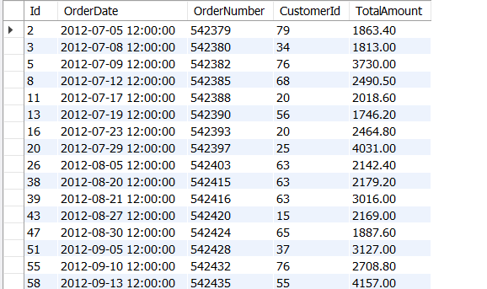
17.Retrieve all orders that had a total amount above the average order amount. Code: select * from orders where TotalAmount >(select avg(TotalAmount) from orders);

Slide 17


AGGREGATE FUNCTIONS
18.What is the average quantity per order item?
Code:
select avg(quantity) as average_quantity from orderitem;
19.What’s the maximum unit price of any product? Code: select max(unitprice) as maximum_unit_price from orderitem;

Slide 18
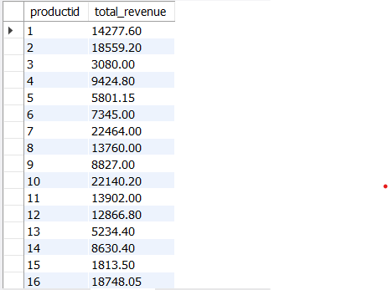
20.Find the total revenue generated per product. Code: select productid,sum(quantity*unitprice) as total_revenue from orderitem group by 1;

